Slide 1

Department of CSE
Course: AI & ML
Course code: 24AD2001A
Topic:
one-class SVM, autoencoders (as preview).
Session – 36

Slide 2
one-class SVM
One-Class Support Vector Machine is a special variant of Support Vector Machine that is primarily designed for outlier, anomaly, or novelty detection. The objective behind using one-class SVM is to identify instances that deviate significantly from the norm. Unlike other traditional Machine Learning models, one-class SVM is not used to perform binary or multiclass classification tasks but to detect outliers or novelties within the dataset. Some of the key working principles of one-class SVM is discussed below.
Outlier Boundary: One-Class SVM operates by defining a boundary around the majority class (normal instances) in the feature space. This boundary is constructed to encapsulate the normal data points, effectively creating a region of normalcy.
Margin Maximization: This algorithm strives to maximize the margin around the normal instances, allowing for a more robust separation between normal and anomalous data points. This margin is crucial for accurately identifying outliers during testing.
High sensitivity: One-Class SVM has an in-build hyperparameter called "nu," representing an upper bound on the fraction of margin errors and support vectors. Fine-tuning this parameter influences the model's sensitivity to outliers.

Slide 3
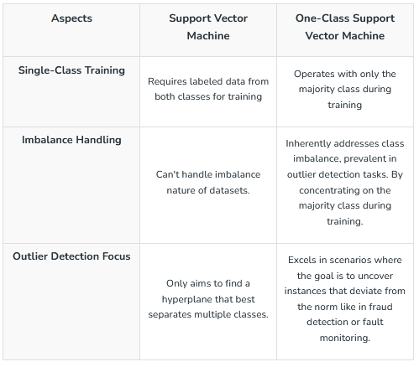
How does One-Class SVM differ from SVM?
SVM and one-class SVMs are like twins but not identical twins, as their usage and principals are different. The three most common differences are discussed below:

Slide 4
How One-Class SVM Works?
One-Class Support Vector Machines (OCSVM) operate on a fascinating principle inspired by the idea of isolating the norm from the abnormal in a dataset. Unlike traditional Support Vector Machines (SVM), which are adept at handling binary and multiclass classification problems, OCSVM specializes in the nuanced task of anomaly detection. The workflow of OCSVM is discussed below:
1. Conceptual Foundation: OCSVM establishes itself on the premise that the majority of real-world data is inherently normal. In most scenarios, outliers or anomalies are rare occurrences that deviate significantly from the usual patterns. OCSVM's goal is to define a boundary encapsulating the normal instances in the feature space, thereby creating a region of familiarity.

Slide 5
CONTD..
2. Outlier Boundary Definition: The algorithm crafts a boundary around the normal instances, often referred to as the "normalcy region." This boundary is strategically positioned to maximize the margin around the normal data points, allowing for a clear delineation between what is considered ordinary and what may be deemed unusual. Think of it as drawing a protective circle around the typical instances to shield them from the outliers or anomalies.
3. Margin Maximization: The heart of OCSVM lies in its commitment to maximizing the margin between the normal instances and the boundary. A larger margin provides a robust separation, enhancing the model's ability to discern anomalies during testing. This emphasis on margin maximization is akin to creating a safety buffer around the normal instances, fortifying the model against the influence of potential outliers or anomalies.

Slide 6
CONTD..
4. Training Process: During the training phase, OCSVM exclusively leverages the majority class or normal instances. This unimodal focus distinguishes it from traditional SVMs, which necessitate examples from both classes for effective training. By concentrating solely on the norm, OCSVM tailors itself to scenarios where anomalies are sparse, and labeled instances of anomalies are hard to come by. It comes with a fantastic hyperparameter called 'nu'. This parameter acts as an upper bound on the fraction of margin errors and support vectors allowed by the model. Tuning the nu parameter enables practitioners to strike a balance between the desire for a stringent model that minimizes false positives (normal instances misclassified as anomalies) and a more lenient model that embraces a higher fraction of anomalies.
5. Testing and Anomaly Identification: Armed with the learned normalcy region, OCSVM can swiftly identify anomalies during testing. Instances falling outside the defined boundary are flagged as potential outliers. The model essentially acts as a vigilant guardian, scrutinizing new data points and signaling if they exhibit behavior significantly different from the norm.

Slide 7
One-Class SVM in Anomaly Detection
In the domain of anomaly detection, One-Class Support Vector Machines (OCSVM) serve as a robust and versatile tool designed to discern normal patterns from irregular occurrences. Notably, OCSVM takes a distinctive approach by training exclusively on the majority class, which represents normal instances, eliminating the need for labeled anomalous data during training. This is particularly advantageous in real-world scenarios where anomalies are rare, making it challenging to obtain sufficient labeled samples. The core principle of OCSVM involves defining a boundary around the normal instances in the feature space, achieved through a specified kernel function and a nuanced parameter termed "nu."

Slide 8
CONTd..
This parameter acts as an upper limit on the fraction of margin errors and support vectors, enabling users to fine-tune the model's sensitivity to outliers. During the testing phase, instances falling outside this learned boundary are flagged as potential outliers, facilitating efficient anomaly identification. OCSVM's adaptability extends to various applications, including fraud detection in financial transactions, fault monitoring in industrial systems, and network intrusion detection. Its innate ability to capture complex, non-linear relationships and its focus on the majority class make it a valuable asset in safeguarding systems against unexpected events and ensuring robust anomaly detection across diverse domains. In this article, we will implement credit card anomaly detect using OCSVM further.

Slide 9
autoencoders
An autoencoder is an artificial neural network used for unsupervised learning tasks (i.e., no class labels or labeled data) such as dimensionality reduction, feature extraction, and data compression. They seek to:
Accept an input set of data (i.e., the input)
Internally compress the input data into a latent space representation (i.e., a single vector that compresses and quantifies the input)
Reconstruct the input data from this latent representation (i.e., the output)
An autoencoder consists of the following two primary components:

Slide 10
CONTD..
Encoder: The encoder compresses input data into a lower-dimensional representation known as the latent space or code. This latent space, often called embedding, aims to retain as much information as possible, allowing the decoder to reconstruct the data with high precision. If we denote our input data as and the encoder as , then the output latent space representation, , would be .
Decoder: The decoder reconstructs the original input data by accepting the latent space representation . If we denote the decoder function as and the output of the detector as , then we can represent the decoder as .
Both encoder and decoder are typically composed of one or more layers, which can be fully connected, convolutional, or recurrent, depending on the input data’s nature and the autoencoder’s architecture.

Slide 11

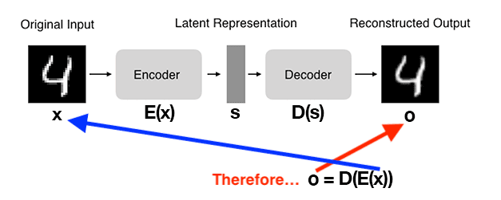
CONTD..
By using our mathematical notation, the entire training process of the autoencoder can be written as follows:

Slide 12
CONTD..
In this example, you can observe the following steps:
We input a digit into the autoencoder.
The encoder subnetwork generates a latent representation of the digit 4
, which is considerably smaller in dimensionality than the input.
The decoder subnetwork reconstructs the original digit using the latent representation.

Slide 13
THANK YOU
Team – AI &ML

